Slide 1
You Say COVID and I Say Covfefe – Let’s Call the Whole Thing Off
The Nuts and Bolts and Legal Issues of Reopening the Office in the Time of COVID-19
Presented by Kevin Allen and Jennifer Schlatter with Allen Vellone Wolf Helfrich & Factor P.C.

Slide 2
IF YOU ARE ATTENDING THIS PRESENTATION, BY CLICKING BELOW YOU AGREE TO NOT SUE US IF YOU CONTRACT CORONAVIRUS
REGISTER

Slide 3
GUIDELINES AND RESOURCES
FEDERAL GOVERNMENT
STATE GOVERNMENT
CDC
OSHA
EEOC

Slide 4
FEDERAL GOVERNMENT: OPENING UP AMERICA AGAIN!

Slide 5
FEDERAL GOVERNMENT: OPENING UP AMERICA AGAIN!
The White House has published non-binding guidelines for states and localities to consider in determining when and how to reopen businesses, schools, and other gatherings, and lift other COVID mitigation restrictions.
Guidelines are a set of recommendations for a three-phased reopening in jurisdictions that satisfy broad “gating criteria” based on evaluation of data related to symptoms, COVID cases, the downward trajectory of symptoms in cases, hospital loads and capacity, and robust testing for at-risk healthcare workers.
Although non-binding, the Guidelines will likely provide some of the criteria that will be incorporated by a number of jurisdictions.

Slide 6
FEDERAL GOVERNMENT: OPENING UP AMERICA AGAIN! Employer Roles & Responsibilities
The Guidelines recommend that, during each phase, an employer should:
Develop and implement appropriate policies, in accordance with federal, state, and local regulations and guidance, and informed by industry best practices, regarding such topics as social distancing and protective equipment, sanitation, and business travel;
Monitor its workforce for indicative symptoms, including prohibiting symptomatic people from physically returning to work until cleared by a medical provider; and
Develop and implement policies and procedures for workforce contact tracing following employee COVID+ tests.

Slide 7
FEDERAL GOVERNMENT: OPENING UP AMERICA AGAIN! Employer Roles & Responsibilities
During Phase One, the Guidelines recommend that employers:
Continue to encourage teleworking, whenever possible and feasible with business operations;
If possible, return to work in phases;
Close common areas or enforce strict social distancing protocols;
Minimize non-essential travel and adhere to CDC guidelines regarding isolation following travel; and
Strongly consider special accommodations for personnel who are members of a vulnerable population (e.g., elderly individuals and individuals with serious underlying health conditions).

Slide 8
FEDERAL GOVERNMENT: OPENING UP AMERICA AGAIN! Employer Roles & Responsibilities
During Phase Two, the Guidelines recommend that employers:
Continue to encourage teleworking, whenever possible and feasible with business operations;
Keep common areas closed or enforce moderate social distancing protocols; and
Strongly consider special accommodations for personnel who are members of a vulnerable population.

Slide 9
FEDERAL GOVERNMENT: OPENING UP AMERICA AGAIN! Employer Roles & Responsibilities
During Phase Three, the Guidelines suggest employers may resume unrestricted staffing of worksites.

Slide 10
STATE GOVERNMENT

Slide 11
CO: LEVELS OF PROTECTION DURING PANDEMIC
Level 1: Stay at Home. Lasted until April 27.
Level 2: Safer at Home. Commenced April 27. Set to initially expire 30 days from April 27. Gov. Polis extended the Safer at Home Order to June 1.
On June 1, Polis signed Executive Order which transitioned Colorado from Safer-at-Home to what he is calling “Safer at Home in the Vast, Great Outdoors.” Order is in place until July 1, easing some restrictions, more leeway for state’s older residents.
Level 3: Protect Our Neighbors. The final level where it is safer for people to socialize more normally, while taking significant precautions.

Slide 12
GOV. POLIS GUIDANCE TO EMPLOYERS
On May 21, 2020, Governor Polis issued “Guidance to Employers and Places of Public Accommodation Regarding Equal Opportunity Employment and Reasonable Accommodations Due to the Presence of COVID-19 (“Guidance”).
Make reasonable accommodations for individuals with disabilities (absent undue hardship).
Follow evolving guidance from state and local public health authorities as COVID-19 evolves, following most current information on maintaining workplace safety.
Employers with employees covered by the ADA may ask such employees if they are experiencing symptoms COVID-19, which include fever, chills, cough shortness of breath, or sore throat.
Consider or maintain all information about employee illness as a confidential medical record in compliance with the ADA.

Slide 13
GOV. POLIS GUIDANCE TO EMPLOYERS CONT.
May require a doctor’s note certifying fitness for duty. May also rely upon local clinics to provide a form, a stamp, or e-mail to certify than an individual does not have COVID-19.
May screen job applicants for symptoms of COVID-19 after making a conditional job offer, as long as it does so for all entering employees in the same type of job. ADA rule applies whether or not the applicant has a disability.
May withdraw a job offer if the employer needs the applicant to start immediately but the individual has COVID-19 or symptoms of COVID-19.

Slide 14
GOV. POLIS GUIDANCE TO EMPLOYERS CONT.
May not postpone or withdraw a job offer because the individual is at a higher risk of contracting COVID-19, such as being 65 years old or pregnant. Being a Vulnerable Individual does not justify unilaterally postponing the start date or withdrawing a job offer. However, an employer should consider allowing telework or to discuss with these individuals if they would like to postpone the start date.
With respect to Vulnerable Individuals, has been expanded by Executive Order by Polis on June 1, to state that Vulnerable Individuals cannot be compelled to perform in-person work for any business or government function, including a Critical Business or Critical Government Function.
Make reasonable accommodations to offer protection to an individual whose disability puts that individual at a greater risk of contracting COVID-19 and who therefore requests accommodations actions to eliminate possible exposure.

Slide 15
GOV. POLIS GUIDANCE TO EMPLOYERS CONT.
Employers are encouraged to consider accommodations for those who request reduced contact with others due to a disability, which may include changes to the work environment that reduce chances of exposure to COVID-19.
Encouraged to implement temporary job restructuring of marginal duties, temporary transfers to a different position, or modifying a work schedule or shift assignments to allow individuals with a disability to perform essential functions of a job safely.
Employers may consider whether current circumstances create “significant difficulty” in acquiring or providing certain accommodations, considering the duties of a particular job and workplace environment (such as acquiring certain items necessary to provide accommodations, temporary assignments, etc.).

Slide 16
GOV. POLIS GUIDANCE TO EMPLOYERS CONT.
Employers encouraged to provide reasonable accommodations so long as they do not pose an “undue hardship” which means “significant difficulty or expense.
May require employees to wear protective gear, such as facial coverings and gloves and observe infection control practices. However, where an employee with a disability needs a related reasonable accommodation under ADA, such as non-latex gloves or modified facial coverings, or a religious accommodation under Title VI (modified equipment due to religious garb), employer should discuss the request and provide necessary modification or an alternative if feasible and does not cause undue hardship.
Employees must let employer know if a reasonable accommodation is needed.
Check the Bar Associations for other states as such associations may have issued guidance for re-opening law firms that may provide assistance. For example, the New York Bar Association issued a Guidance on Re-Opening Law Firms.

Slide 17
RETURN TO WORK BEST PRACTICES UNDER “SAFER AT HOME”
Develop a comprehensive infectious disease preparedness and response plan, including identifying a workplace coordinator who will be responsible for COVID-19 issues and their impact on the workplace.
Implement basic infection prevention measures: proper hand hygiene, routine cleaning and disinfecting practices, and the use of personal protective equipment (PPE), etc.
Develop policies and procedures for prompt identification and isolation of sick people, such as temperature testing for employees.
Develop, implement, and communicate about workplace flexibilities and protections, e.g., distribute information about the Families First Coronavirus Response Act (FFCRA) sick leave provisions.
Post signage for employees and clients on good hygiene and new office practices, and make regular announcements to remind employees and/or customers to follow distancing guidelines.

Slide 19
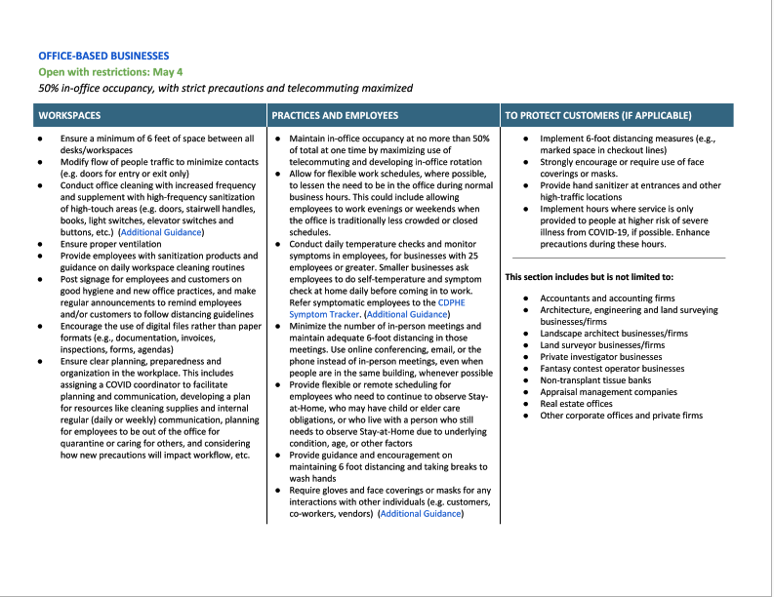

Slide 20
Check State Local County Ordinances
Counties of Colorado may each have their own set of ordinances that would be in addition to those established by Gov. Polis. Therefore, employers should visit the county government websites to make sure their offices are in compliance with those rules as well.
For example, on June 5, Denver County established Public and Business Guidelines, establishing criteria and requirements for business reopening, which included guidelines on testing and contact tracing. Many of the guidelines track those established by the State, CDC, OSHA, etc.
Denver County website also has downloadable resources, such as signs and forms for face coverings, handwashing, and employee health screening. (https://www.denvergov.org/content/denvergov/en/covid-19/recovery-guidance/guidance-for-businesses.html)

Slide 21
CENTERS FOR DISEASE CONTROL AND PREVENTION

Slide 22
CDC GUIDANCE
Changes are fluid. Recent changes occurred on May 6, 2020 and include:
Conducting daily health checks
Conducting a hazard assessment of the workplace
Encouraging employees to wear cloth face coverings in the workplace, if appropriate
Implementing policies and practices for social distancing in the workplace
Improving the building ventilation system

Slide 23
CDC GUIDANCE CONT.
Identify a workplace coordinator who will be responsible for COVID-19 issues and their impact at the workplace.
Examine policies for leave, telework, and employee compensation.
Leave policies should be flexible and non-punitive, and allow sick employees to stay home and away from co-workers. Leave policies should also account for employees who need to stay home with their children if there are school or childcare closures, or to care for sick family members.
When possible, use flexible worksites (e.g., telework) and flexible work hours (e.g., staggered shifts) to help establish policies and practices for social distancing (maintaining distance of approximately 6 feet or 2 meters) between employees and others, especially if social distancing is recommended by state and local health authorities.

Slide 24
CDC GUIDANCE CONT.
Review your leave policies with all employees and provide information about available employee assistance services. Share information on steps they can take to protect themselves at work and at home.
Identify essential employees and business functions, and other critical inputs such as raw materials, suppliers, subcontractor services/products, and logistics required to maintain business operations. Explore ways you can continue business operations if there are disruptions.
Prepare business continuity plans for significant absenteeism, supply chain disruptions, or changes in the way you need to conduct business.
Establish an emergency communications plan. Identify key contacts (with back-ups), chain of communications (including suppliers and customers), and processes for tracking and communicating about business and employee status.
Share your response plans with employees and clearly communicate expectations. It is important to let employees know plans and expectations if COVID-19 occurs in communities where you have a workplace.

Slide 25
OCCUPATIONAL SAFETY AND HEALTH ADMINISTRATION

Slide 26
OSHA
OSHA has prepared their own guidance on preparing workplaces for COVID, available on OSHA website, CDC website. The guidance's are similar to the ones discussed herein, but have their own nuances. Therefore, employers should continue to check the OSHA website for updates.
https://www.osha.gov/SLTC/covid-19/
https://www.osha.gov/SLTC/covid-19/news_updates.html
Guidance on Preparing Workplaces for Covid-19: https://www.osha.gov/Publications/OSHA3990.pdf

Slide 27
OSHA
OSHA’s Enforcement Guidance for Recording Cases of COVID-19, specifies that COVID-19 is a recordable illness and that employers are responsible for recording cases of COVID-19 if:
The case is a confirmed case of COVID-19;
The case is work-related, as defined by 29 C.F.R. 1904.5; and
The case involves one or more of the general recording criteria set forth in 29 C.F.R. 1904.7, such as medical treatment beyond first aid or days away from work.
On April 10, 2020, OSHA issued relaxed its recordkeeping requirements for employers, other than those in the healthcare industry, emergency response organizations, and correctional institutions, announcing that it will not enforce its recordkeeping requirements, except where (1) there is objective evidence that a COVID-19 case may be work-related; and (2) The evidence was reasonably available to the employer.

Slide 28
OSHA
On May 19, OSHA issued Revised Enforcement Guidance for Recording Cases of COVID-19. Reinstated the above specifications for when COVID-19 is a recordable illness.
Guidance provides new information for employers on how to determine if COVID-19 is “work-related.” Because of the difficulty with determining work-relatedness, OSHA will “exercise[e] enforcement discretion to assess employers' efforts in making work-related determinations and consider multiple factors, including:
The reasonableness of the employer's investigation into work-relatedness;
The evidence available to the employer; and
The evidence that a COVID-19 illness was contracted at work.
If, after the reasonable and good faith inquiry described above, the employer cannot determine whether it is more likely than not that exposure in the workplace played a causal role with respect to a particular case of COVID-19, the employer does not need to record that COVID-19 illness.

Slide 29
EQUAL EMPLOYMENT OPPORTUNITY COMMISSION

Slide 30
EEOC
In 2009, the EEOC issued a Guidance called the Pandemic Preparedness in the Workplace and the Americans with Disabilities Act.
The EEOC Guidance was re-issued in March 21, 2020 to address the COVID-19 pandemic. The particulars and language of the EEOC Guidance is tracked by Gov. Polis’s Guidance to Employers issued on May 21, 2020, previously discussed.
The EEOC Guidance covers return-to-work issues for disability-related inquiries, pre-entry medical screens, retention of medical information, and personal protective gear.
The EEOC Guidance are continually updated and inform employers as to the best practices for balancing obligations under the ADA, ADEA and complying with guidelines issued from the CDC.

Slide 31
MEDICAL SCREENINGS

Slide 32
Colorado Safer at Home Order
Employers are to conduct daily temperature checks and monitor symptoms in employees at the worksite to the greatest extent possible.
If daily checks at worksite not practicable, through employee self-assessment at home prior to coming to the worksite.
Employers with over 50 employees in any one location shall, in addition to the above requirements, implement employee screening systems that follow the above requirements in one of the following ways: (1) set up stations at the worksite for symptom screening and temperature checks; or (2) create a business policy that requires at-home employee e self-screening each work day and reporting of the results to the employer prior to entering the worksite.

Slide 33
Temperature Check Protocol
Employers should be aware that some people with COVID-19 do not show signs of a fever or are asymptomatic. However, temperature checks are still useful in identifying possible positive cases and help prevent an outbreak in the workplace.
Equipment For Temperature Checks
4-6 touchless thermometers.
Alcohol or disinfecting wipes to clean thermometer after each use
Hand sanitizer
Disposable gloves
Employee health screening forms for logging daily checks

Slide 34
Temperature Check Protocol
Tests should be administered consistently and in a non-discriminatory manner. The EEOC has issued guidance confirming that temperature checks are a permissible screening mechanism to use during the COVID-19 pandemic.
Establish baseline temperature that will be considered too high for the employee to enter the workplace. CDC considers a person to have a fever when he or she has a measured temperature of 100.4° F or greater.
Provide prior notice of screening to all employees, staff and visitors. For example, posting notices at the door or front desk.
Screenings should be as private as possible.
If an employee exhibits symptoms, such as an elevated temperature, the employee should be informed in private immediately that s/he is not allowed to enter the workplace.
Employers should refer to the CDC’s Guidance for Businesses and Employers to Plan and Respond to COVID-19 for updates.

Slide 35
Other Screening Protocols
Employers may implement daily self-assessment and/or certification forms in which an employee is asked to self-report temperature, other symptoms, or potential exposure events.
All medical information about a particular employee, including any documented health screening results, must be stored separately from the employee's personnel file.
This includes an employee’s statement that s/he has the disease or suspects s/he has the disease, or the employer’s notes or other documentation from questioning an employee about symptoms.
Employers should rely on the CDC and other public health authorities for guidance on emerging symptoms associated with COVID-19, and update company self-assessment and/or certification forms as needed.

Slide 37
Contact-Tracing and Monitoring Apps

Slide 38
Contact-Tracing and Monitoring Apps
Social-distancing wristbands that monitor distance between employees and vibrate if employees get too close to each other.
Geolocation devices that track workers’ movements with GPS and send data to the Cloud.
Contact-tracing apps that tracks how close employees get to each other by noting their smartphones' Bluetooth and Wi-Fi signals.
Apps that enable companies to create online employee health surveys and map the workplace locations visited by employees with coronavirus infections.
RFID-enabled lanyards that record which rooms workers enter or exit, and whether they washed their hands or used hand sanitizer.
Biometric technology to take employees’ temperatures with a thermal camera.

Slide 39
Legal Issues Relating to Use of Contact Tracing Apps
ADA prohibits employee disability-related inquiries or medical exams unless they are job-related and consistent with “business necessity.” Business necessity means an employer has a reasonable belief that (1) employee’s ability to perform essential job functions will be impaired by medical condition; or (2) employee will pose direct threat due to medical condition.
EEOC issued guidance that due to COVID-19, employer may require medical examinations of employees, provided exams are consistent with “business necessity.”
Employers may make inquiries that are not disability-related (i.e., not likely to elicit information about a disability), such as inquiring about travel-related exposure to pandemic viruses such as COVID-19, regardless of whether COVID-19 constitutes a “direct threat.”

Slide 40
Legal Issues Cont.
HIPPA, which would require employer to obtain written authorization from employee for purposes of obtaining, using and disclosing employee health and geolocation data and other tracing purposes
State data privacy and security laws, such as Colorado’s Protections for Consumer Data Privacy Act, to which employers are subject.
May implicate Colorado lawful off-duty conduct if employer requires use of the app for monitoring purposes while the employee is off duty.

Slide 41
Employer Considerations Regarding Contact Tracing
Maintain the confidentiality of employee data, particularly medical information. Make sure to designate administrative access only to select personnel who need to know if an employee tests positive for COVID-19.
Collect as little data as possible or store data for short periods of time.
Develop clear policies that describe how the technology works, what data is collected, how the data and app or other technology will be used.
Notify employees whether use of the app or technology will require compensable time.
Make certain that use of the app or other technology is accessible to employees with disabilities and that reasonable accommodations are available.
Undertake measures to keep that information secure and confidential.
Update any Employee Manuals to include references to use of contact tracing, and require employees’ written acknowledgment and consent to use of the technology.

Slide 42
BEST PRACTICES FOR HYGIENE IN WORKPLACE

Slide 43
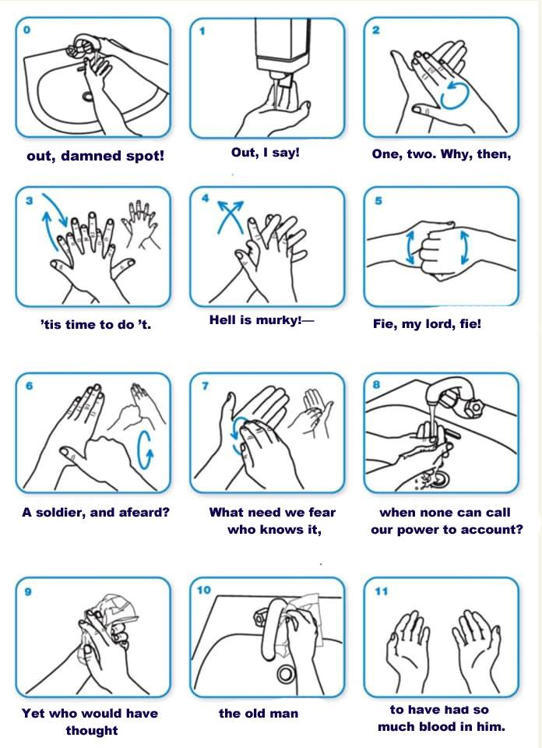
Frequently wash your hands with soap and water for at least 20 seconds. The CDC recommends singing “Happy Birthday.” But we all hate that song.
The chorus of “Stayin’ Alive” by the Bee Gees is 24 seconds long, so you are assured of clean hands.
For hip older people or the younger generation, sing the chorus for Lizzo’s “Truth Hurts.”
You can tell your children to sing “It’s a Small World,” but you will be singing that song forever. Starting now. You’re welcome.
For the highbrow, Lady Macbeth’s monologue of “out, damned spot” (accompanying meme courtesy of the Fossilheads).

Slide 44
Avoid touching your eyes, nose, or mouth with unwashed hands.
If soap and running water are not available, use an alcohol based hand rub that contains at least 60% alcohol.
Put sanitizing hand rub dispensers in prominent places around the workplace. Make sure these dispensers are regularly refilled.
Routinely clean all frequently touched surfaces in the workplace, such as desks, doorknobs, keyboards, mouse and mouse pad, desk drawer handles, phones, countertops in breakroom.
Employers should provide disposable wipes or other cleaning supplies for employees to clean down their work spaces and other common surfaces.
Provide clients and the public with tissues and trash receptacles and access to sanitizer.
Encourage respiratory etiquette, including covering coughs and sneezes.

Slide 45
Discourage workers from using other workers’ phones, desks, offices, or other work tools and equipment, when possible.
Maintain regular housekeeping practices, including routine cleaning and disinfecting of surfaces, equipment, and other elements of the work environment.
When choosing cleaning chemicals, employers should consult information on Environmental Protection Agency (EPA)-approved disinfectant labels with claims against emerging viral pathogens. Products with EPA-approved emerging viral pathogens claims are expected to be effective against SARS-CoV-2 based on data for harder to kill viruses.
Provide a face mask, if feasible and available, and ask employees to wear it, if tolerated and in compliance with ADA or Title VII.

Slide 46
MAKING YOUR PLAN TO CLEAN AND DISINFECT
Cleaning with soap and water removes germs, dirt, and
impurities from surfaces. It lowers the risk of spreading infection.
Disinfecting kills germs on surfaces. By killing germs on a surface
after cleaning, it can further lower the risk of spreading infection.
Is the area indoors?
YES
NO
It is an indoor area.
Maintain existing cleaning practices.
Coronaviruses naturally die in hours to days in typical indoor and outdoor environments. Viruses are killed more quickly by warmer temperatures and sunlight.
Has the area been occupied within the last 7 days?
YES NO
Yes, the area has been occupied within the last 7 days.
The area has been unoccupied within the last 7 days.
The area will need only routine cleaning.
Is it a frequently touched surface or object?
YES
NO
Yes, it is a frequently touched surface orobject.
Thoroughly clean these materials.
Consider setting a schedule for routine cleaning and disinfection, as appropriate
What type of material is the surface orobject?
Hard and non-porous materials like glass, metal, or plastic
Visibly dirty surfaces should be cleaned priorto disinfection. Consult EPA’s
list of disinfectants for use against COVID-19, specifically for use on hard,
non-porous surfaces and for your specific application need. More frequent
cleaning and disinfection is necessary to reduce exposure.
Soft and porous materials like carpet, rugs, or material in seating areas.
Thoroughly clean or launder materials.
Consider removing soft and porous materials in high traffic areas. Disinfect materials if appropriate products are available

Slide 47
SOCIAL DISTANCING Beginning May 4, 2020, non-critical businesses were allowed to bring back fifty percent (50%) of their employees to return to the workplace, subject to social distancing protocols.

Slide 48
Maximizing use of telecommuting and developing in-office rotation.
Allow for flexible work schedules, where possible, to lessen the need to be in the office during normal business hours. This could include allowing employees to work evenings or weekends when the office is traditionally less crowded or closed schedules.
Minimize the number of in-person meetings and maintain adequate 6-foot distancing in those meetings. Use online conferencing, email, or the phone instead of in-person meetings, even when people are in the same building, whenever possible.
Ensure a minimum of 6 feet of space between all desks/workspaces.
Stagger breaks and rearrange seating in common break areas to maintain physical distance between employees.

Slide 49
Provide flexible or remote scheduling for employees who need to continue to observe Stay- at-Home, who may have child or elder care obligations, or who live with a person who still needs to observe Stay-at-Home due to underlying condition, age, or other factors.
Encourage employees to stay home if they are sick.
Isolate any employee who begins to exhibit symptoms until they can either go home or leave to seek medical care.
Bathrooms should have signs reminding people of social distancing, such as the use of every other stall. Consider making disinfectant wipes available to open, close and wipe down bathroom doors.
Discourage handshaking or other close contact.

Slide 50
For larger firms and office spaces, create one-way directional hallways to ease foot traffic congestion. Everyone will be required to wear a mask unless they're alone in their individual office.
For employees utilizing public transportation, employees should wear masks at all times and upon arrival at the office, wash their hands.
Instruct employees to refrain from using an elevator that has more than three people on it, depending on the size of the elevator. And wear a mask while on the elevator.
Encourage employees to bring any safety and health concerns to the employer’s attention.

Slide 51
LEGAL ISSUES RELATED TO COVID-19

Slide 52
Families First Coronavirus Response Act requires certain employers to provide paid sick leave to employees who are sick, need to quarantine or self-isolate, care for a sick or quarantined family member, or care for a child whose school has been closed. The Act is limited to the coronavirus pandemic and goes into effect 15 days after enactment, or April 2, 2020, and expires on December 31, 2020.
Many employers are moving toward having employees work from home instead of coming to the workplace. An employer may encourage or require employees to telework as an infection-control or prevention strategy, including based on timely information from public health authorities about pandemics, public health emergencies, or other similar conditions. Telework also may be a reasonable accommodation. Employers must not single out employees either to telework or to continue reporting to the workplace on a basis prohibited by any of the EEO laws.
The ADA requires employers to make reasonable accommodations for employees with disabilities. Although it is not clear that having COVID-19 would rise to the level of a disability for most employees, employees who are particularly susceptible to complications if they were to contract the disease may be eligible for reasonable accommodation, such as continued telework.

Slide 53
OSHA WHISTLEBLOWER CLAIMS
Due to the COVID-19 pandemic, whistleblower and retaliation claims against employers have risen as a result of employees raising concerns that employers are not taking proper safety and health measures, which claims are often raised with OSHA pursuant to Section 11(c) of the OSHA Act of 1970
OSHA investigators rely upon the following factors that an employee must demonstrate, by a preponderance of evidence, for a prima facie case of retaliation (1) the alleged victim engaged in a protected activity, (2) the alleged victim suffered an adverse employment action, and (3) a causal link between the protected activity and the adverse employment action.
Protected activity includes actions such as (1) filing a complaint or instituting a proceeding under the act; (2) testifying in a proceeding under the Act; and (3) exercising a right granted by the act, such as reporting safety concerns or workplace injuries.

Slide 54
OSHA WHISTLEBLOWER CLAIMS CONT.
Under OSHA, employees are only entitled to refuse to work if they believe they are in imminent danger, which is defined as “any conditions or practices in any place of employment which are such that a danger exists which can reasonably be expected to cause death or serious physical harm immediately or before the imminence of such danger can be eliminated through the enforcement procedures otherwise provided by this Act.”
The threat must be immediate or imminent, which means that an employee must believe that death or serious physical harm could occur within a short time.
If an employer has taken necessary measures to clean the work environment more regularly and create social distancing mechanisms to keep employees six feet or more apart, require the wearing of masks, they are reducing the risk of exposure and likely not creating an environment that involves increased risk of death or physical harm, as it relates to the COVID-19 pandemic.
Feeling “unsafe” on its own is typically not sufficient to refuse to work, especially if an employer has undertaken the proper measures.

Slide 55
WORKERS COMPENSATION
Workers’ compensation generally provide the exclusive remedy for injuries and occupational illnesses that employees suffer arising out of and within the course of their employment.
The law is unclear as to whether an employee who contracts COVID-19 during employment will qualify for workers’ compensation. Some factors that may be considered is whether the employee was required to work in a “hot zone” (for example, claims are rising in the meat packing industry).
Employers should avoid requiring an employee to execute a waiver whereby the employee waives a claim for a COVID-19 related illness arising out of workplace exposure. Waiver may be evidence that the employer is attempting to avoid its statutory obligation under OSHA.
Asking an employee to sign a waiver also effectively requires the employee to assume the risk the workplace is unsafe, which could violate employer’s obligation under OSHA.

Slide 56
Kevin D. Allen
Jennifer E. Schlatter
Allen Vellone Wolf Helfrich & Factor P.C.
1600 Stout St., Suite 1900
Denver, CO 80202
(303) 534-4499
kallen@allen-vellone.com
jschlatter@allen-vellone.com

